Slide 1


HealthData: Managing Medical Records with a DBMS
Presented By:
Aryan Kumar (AP22110010120)
Krishna Sharma (AP22110010128)
Tejash Tarun (AP22110010110)
Ankit Jha (AP22110010130)

Slide 2
Table of contents
Introduction
Project Objective
Expected outcomes
Er diagram
Normalize table
Benefit and impact
conclusion

Slide 3


Introduction
The "HealthData" project addresses the pressing need for efficient management of medical records in healthcare institutions by employing a robust Database Management System (DBMS). With the exponential growth and complexity of medical data, traditional paper-based systems are no longer adequate. The transition to electronic health records (EHRs) emphasizes the necessity for secure, scalable, and accessible data storage solutions. Effective management of medical records is crucial for high-quality patient care, regulatory compliance, research facilitation, and operational efficiency within healthcare organizations. HealthData aims to streamline the storage, retrieval, and analysis of medical records while ensuring stringent security and privacy standards are met.

Slide 4
Project Objectives
Centralized Data Repository
Data Security and Privacy
Efficient Data Retrieval
Interoperability
Scalability and Performance
User-Friendly Interface

Slide 5
Expected Outcomes
1
Enhanced patient care through timely access to comprehensive medical records.
2
Improved operational efficiency and productivity within healthcare institutions.
3
Strengthened compliance with regulatory requirements and data protection standards.
4
Facilitated research and analysis through access to aggregated anonymized patient data.
5
Reduced administrative burden associated with manual record-keeping processes.

Slide 6
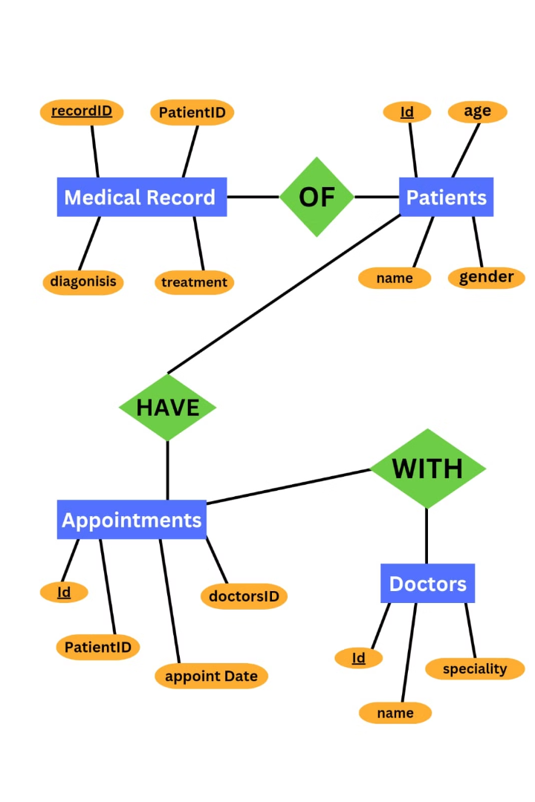
ER Diagram for the Database

Slide 7
Description of ER Diagram
Entities/Tables:
Relationships:
•Patients: Contains personal details (id, name, age, gender).
•Medical Records to Patients: Connects medical records to patients.
•Medical Records: Stores history linked to patients (recordId, patientId, diagnosis, treatment).
•Appointments to Patients: Associates appointments with patients.
•Appointments to Doctors: Links appointments with doctors.
•Appointments: Records appointments (id, patientId, doctorId, appointmentDate).
•Doctors: Holds doctor information (id, name, specialty).

Slide 8


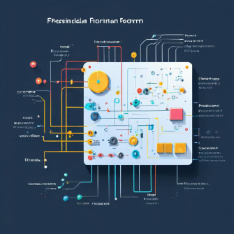
Normalised Table
First Normal Form (1NF)
Second Normal Form (2NF)
Third Normal Form (3NF)
•Each table cell should contain a single value.
•The table must be in 1NF.
•The table must be in 2NF.
•Each record needs to be unique.
• All non-key attributes must be fully functional dependent on the primary key.
• There must be no transitive functional dependencies (i.e., non-key attributes must be dependent only on the primary key).

Slide 9
Benifits and Impacts
Improved Patient Care
Enhanced Efficiency
Data-Driven Insights
HealthData enables healthcare professionals to access comprehensive patient records promptly, leading to more informed decision-making and improved patient outcomes.
By streamlining medical data management processes, Health Data reduces administrative overhead, allowing healthcare institutions to allocate resources more efficiently and focus on delivering quality care.
Health Data provides valuable insights into patient populations, disease trends, treatment outcomes, and clinical best practices through data analytics and reporting capabilities, fostering evidence-based medicine and continuous quality improvement.
Compliance and Security
Cost Savings
Adherence to strict standards mitigates data breach risks, ensuring patient privacy and regulatory trust.
Health Data reduces costs associated with paper records and inefficient processes, leading to significant savings.

Slide 10

Conclusion
In conclusion, the "HealthData" project represents a significant advancement in healthcare management, addressing the critical need for efficient medical record handling. By leveraging a robust Database Management System (DBMS), HealthData streamlines data management processes, leading to improved patient care, enhanced operational efficiency, and cost savings. Additionally, the project's focus on data-driven insights fosters evidence-based medicine and continuous quality improvement. With its adherence to stringent security and compliance standards, HealthData ensures patient privacy and regulatory trust, reinforcing its importance in today's healthcare landscape. Overall, HealthData stands as a pivotal solution for healthcare institutions seeking to optimize patient care delivery while navigating the complexities of modern healthcare data management.

